Slide 1
TELETRAFFIC

Slide 2
Introduction
There are many telephone customers, much larger than the number of available trunks.
Not every customer makes or receives a telephone call at the same time.
The number of trunks connecting the Mobile Switching Center (MSC) A with another MSC B are the number of voice pairs used in the connection (duplex).

Slide 3
Cont...
One of the most important steps in telecommunication engineering is to determine the number of trunks required on a route or a connection between MSCs.
To dimension a route correctly, we must have some idea of its usage, that is, how many subscribers are expected to talk at one time over the route.
The call capacity of an MSC is expressed as the maximum number of originating plus incoming (O I) calls that can be handled during a high-traffic hour while meeting the dial-tone delay requirements.

Slide 4
Traffic Usage
A traffic path is a communication channel, time slot, frequency band, line, trunk, switch, or circuit over which individual communications take place in sequence.
Traffic usage is defined by two parameters, calling rate and call holding time
Calling rate, or the number of times a route or traffic path is used per unit time;
Call holding time, or the average duration of occupancy of a traffic path by a call.

Slide 5

Cont...
The carried traffic is the volume of traffic actually carried by a switch.
offered traffic is the volume of traffic offered to a switch.
The offered load is the sum of the carried load and overflow (traffic that cannot be handled by the switch).

Slide 6
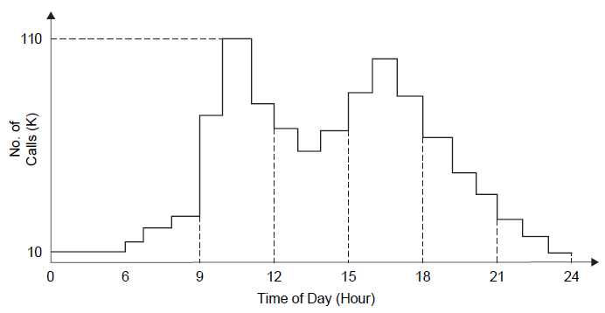
Example of voice traffic variation hour by hour.

Slide 7
Cont...
The figure shows a typical hour-by-hour voice traffic variation for an MSC.
We notice that the busiest period — the busy hour (BH) is between 10 A.M. and 11 A.M.
Busy hour as the span of time (not necessarily a clock hour) that has the highest average traffic load for the business day throughout the busy season.
The peak hour is defined as the clock hour with highest traffic load for a single day.

Slide 8
Cont...
Since traffic also varies from month to month, we define the average busy season (ABS) as the three months (not necessarily consecutive) with the highest average BH traffic load per access line.
Telephone systems are not engineered for maximum peak loads, but for some typical BH load.
The blocking probability is defined as the average ratio of blocked calls to total calls and is referred to as the GoS.

Slide 9
Example
If there are 380 seizures (lines connected for service) and 10 blocked calls (lost calls) during the BH, what is the GoS?
Solution
Blocking Probability = (Number of lost calls)/(Total number of offered calls)
GoS=10/(380+10) = 1/39

Slide 10
Traffic Measurement Units
Traffic intensity is the average number of calls simultaneously in progress during a particular period of time.
It is measured either in units of Erlangs or CCS.
An average of one call in progress during an hour represents a traffic intensity of 1Erlang.
thus 1 Erlang equals 1x3600 call seconds (36 CCS).
The Erlang is a dimensionless number.

Slide 11

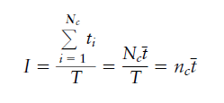
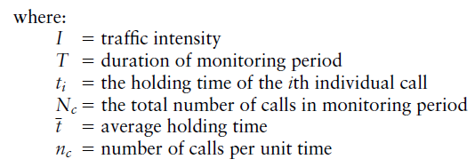
Cont...
Traffic intensity can be obtained as:

Slide 12

Cont...
Percentage of occupancy is the Percentage of time a server is busy.
Peg count is the number of attempts to use a piece of equipment.
The usage (U), peg count (PC) per time period, overflow (O) per period, and average holding time t are related as:

Slide 13
Example
In a switching office an equipment component with an average holding time of 5 seconds has a peg count of 450 for a one-hour period. Assuming that there was no overflow (i.e., the system handled all calls), how much usage in call-seconds, CCS, and Erlangs has accumulated on the piece of the equipment?

Slide 14

Soln

Slide 15

Example
In a wireless network each subscriber generates two calls per hour on the average and a typical call holding time is 120 seconds. What is the traffic intensity?
Solution

Slide 16
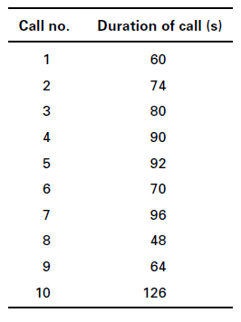
Example
In order to determine voice traffic on a line, we collected the following data during a period of 90 minutes as shown in the table. Calculate the traffic intensity in Erlangs and CCS.

Slide 17

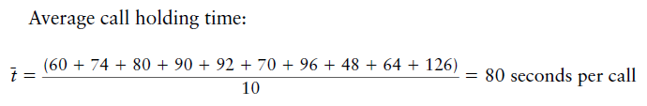

Soln

Slide 18
Grade of Service (GoS)
Is the measure of probability that a percentage of the offered traffic will be blocked or delayed.
Commonly expressed as the fraction of calls that fails to receive immediate services.
For example if GoS is 0.05, then one call out of 20 will be blocked during busy hour.

Slide 19
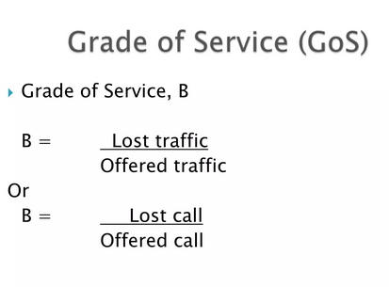

Slide 20
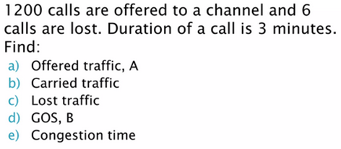
Example

Slide 21
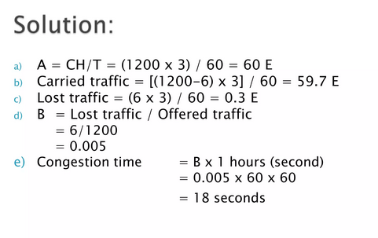

Slide 22
END

